Slide 1
Course Project
Operating Systems
Module 3 Linux Shell Scripts

Slide 2
Rubric
Activity | Requirement(s) | Points
Create a shell script | Answer three questions | 15
Change script file permissions | Take a screenshot | 15
Set the PATH variable | Take a screenshot | 15
Make the PATH variable permanent | Take a screenshot | 15

Slide 3
Create a shell script
1. What are the file permissions of the script?
Answer here: rw-rw-r
2. What’s the name of the user-defined variable in the script?
Answer here: $text
3. Which redirection meta-character is used in the script? What does it do?
Answer here: >> Appends Data to the end of a file.
References:
1. Video of Project
2. Lab Experiance

Slide 4
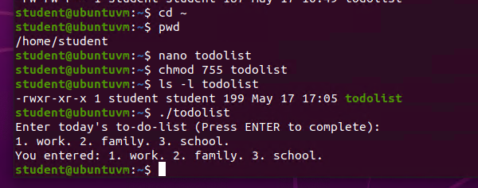
Change script file permissions
Take a screenshot of the output in Step 5.

Slide 5
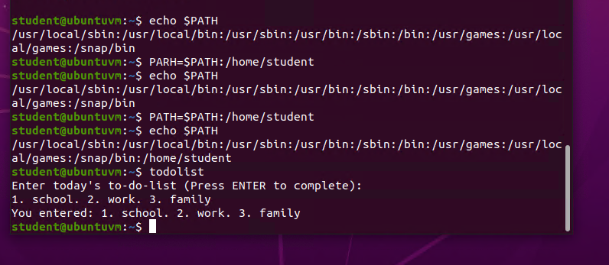
Set the PATH variable
Take a screenshot of the output in Step 6.

Slide 6
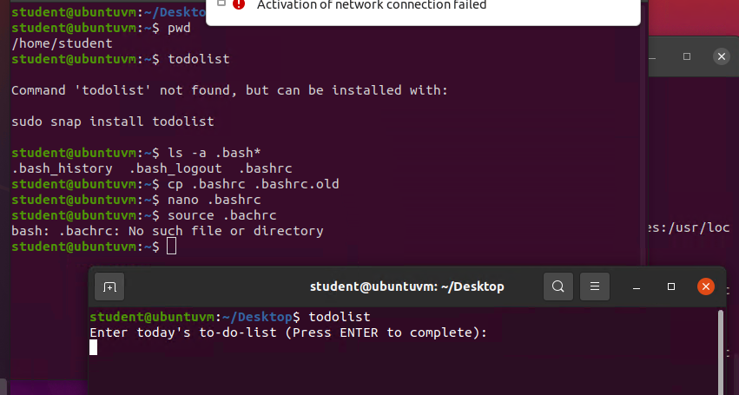
Make the PATH variable permanent
Run the todolist script before and after making the PATH variable permanent. Take a screenshot of both Terminal windows.

